Slide 1
Generating Subjective Responses to Opinionated Articles in Social Media:
An Agenda-Driven Architecture and a Turing-Like Test
Tomer Cagan School of Computer Science The Interdisciplinary Center Herzeliya, Israel cagan.tomer@idc.ac.il | Stefan Frank Centre for Language Studies Radboud University Nijmegen, The Netherlands s.frank@let.ru.nl | Reut Tsarfaty Mathematics and Computer Science Weizmann Institute of Science Rehovot, Israel tsarfaty@weizmann.ac.il
ISCOL 2014 - Haifa, Israel
Notes:
Intro, who we are

Slide 2
Pop Quiz!
“... But make no mistake – this is the best Nexus handset so far by a long shot. We love it and can't recommend it highly enough. It could seriously be a contender for our best smartphone of 2012. If you're due a new phone, you should check the Google Nexus 4 out”
Decide: is the following generated by a human or by a computer?
The author is right. Nexus is okay. iPhone on the other hand is fantastic ...
A fantastic phone for an amazing price!
I think that the author is not really correct because nexus is awful!!!
Awesome phone in affordable price....good job google.
C
H
C
H
Notes:
In good outcome – say that the system works well, lets see how we did it /
In Bad outcome – make a joke (you people are smarter than MT workers)
-- anchor by relating to the goal of the system: going to discuss a system that tries to mimic real human response for online content. Recently, a system passed Turing test – we want to investigate the factors of what is human-like response.

Slide 3
Outline
Motivation and Applications
The Response Generation System
Premises
Definitions
Inner Working
A Walk-Through Example
Turing-Like Evaluation
Conclusions and Future Work
Notes:
Aggregated Overview of the Talk

Slide 4
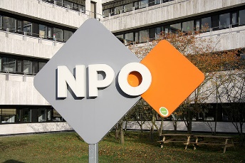
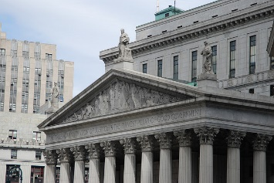
Motivation: Why do we care?
Notes:
Many human interactions are done online.
General news, political campaigns, reviews
In blogs, social networks, news sites...
It is important to understand what constituents/consumers are doing as this affect your “business”.
Thus, plenty of academic research on analysis of the online content

Slide 5
What do we want?
Notes:
Actors (business, government, NPOs) has motivation to interact with the users online (for PR - Spread ideas, promote causes or products
We want to investigate the full cycle – analysis and then response.
Can response generation be done automatically?
What should be in the response?
Can the responses of the system seems/pass as human?

Slide 6
Modeling Assumptions
Why: to achieve some a communicative goal
What: a responder’s disposition towards something: agenda
The responder wants to promote (or demote) certain topics
Each topic may be associated with a certain sentiment
When: triggered by a related event : document
In our case, online document on some topics.
May contain several topics, each topic has associated sentiment.
How: intersect the document with the responder agenda
Generating response for every non-empty intersection
Notes:
Free/non-formal discussion of the model

Slide 7
Modeling Assumptions: Generation
What: Generate utterances that are
Fluent
Human-like
Effectively engage readers
How: We relate to Gricean maxims
Maxim of Quantity → Responses are economic
Maxim of Relation → Responses are relevant
Maxim of Quality → Responses are opinionated
Notes:
Maxim of Quantity: Responses are economic [brief and concise]
Maxim of Relation: Responses are relevant [directly address the documents’ content]
Maxim of Quality: Responses are opinionated [express responders beliefs, sentiments, or dispositions towards the topic(s).]

Slide 8
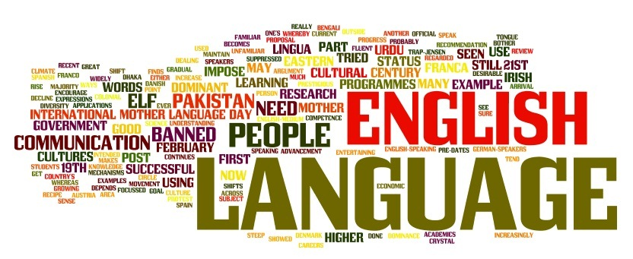
Our Model: Definitions
Notes:
Start formal model - definitions
D – set of online documents
A – set of agendas (in general or for some entity)
S – sentences in English (preferably, grammatical, meaningful ones ;-)
Our functions maps from <D, A> to sentence(s) trying to analyze (decide what to say) and then generate (how to say it, what in the actual response) – corresponding to the arrow directions above.

Slide 9
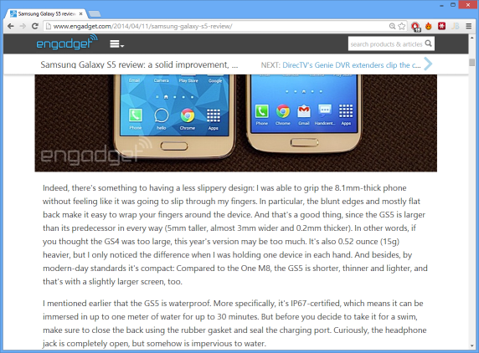
Stage 1: Analysis – What to say
content_element: {
topics: [...],
sentiment: -5,
objectivity: 3,
...
}
Notes:
Analysis of the document extracting its content which should be input for generation.
When we approach this we want to identify what is important input for generation -→ put it in “content element”

Slide 10
Content Element and Agenda
content_element: {
topics: [...],
sentiment: -5,
objectivity: 3,
...
}
content_element: {
topics: [1, 7],
sentiment: -5,
...
}
agenda: {
topics: 1,
sentiment: 4,
}
agenda: {
topics: 1,
sentiment: 4,
}
agenda: {
topics: 1,
sentiment: 4,
}
agenda: {
topics: 7,
sentiment: 3,
}
Notes:
What is the content?
Topic(s),
associated sentiments,
Can also be objectivity, evidentiality, the perceived truthfulness, and so on
we limit (in this work) to topic and sentiment but to get better results we think more should come to play

Slide 11
From Analysis to Generation
Generation: content intersection to response:
What are the shared topics?
How do the sentiments interact?
Agendas
Content
“I think that …
and <object> is really…”
How to construct the response?
Notes:
Intersect the topic/sentiment of agenda and content (matching topics). Can be empty thus no generation

Slide 12
Stage 2: Generation – How to Say It?
Our Goal: to generate human-like responses
That are:
Economic – limited, selective, highly structured
Relevant – document topic(s) feed the generation
Opinionated – agenda defines response sentiment
Notes:
Briefly remind the goal

Slide 13
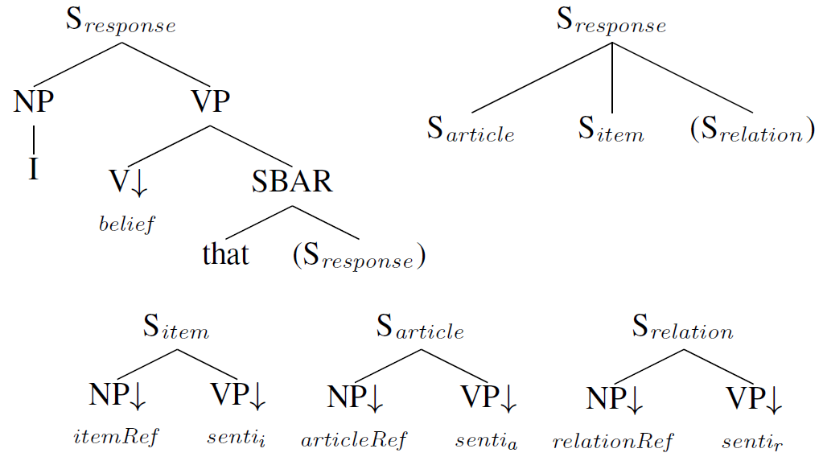
Maxim 1. Economic Responses
Grice (1975): “Make your contribution as informative as required. And no more…”
Using templates
Selective, highly structured
Addresses, at most
The document
The topic/product
Some relation
Notes:
(Maxim of Quantity) Templates are economic. The response are limited to address one or more of the document, product/topic and a related topic.
The expansion of the templates won’t generate long responses. Thus, short responses are not breaching the quantity maxim and efficiently deliver the message

Slide 14
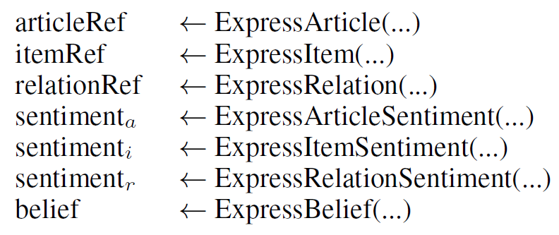
Maxim 2. Relevant Responses
Grice (1975): “Be relevant.”
Refer to
Document
Topic
World knowledge
Notes:
Maxim of relation - The responses are relevant because the generation functions “injects” relevant expressions which are based on the actual input from the document (or agenda). For each, a different function is used.

Slide 15
Maxim 3. Opinionated Responses
Grice (1975): “Don’t say what you believe to be false.”
Sentiment depends on the sentiment in the document and the agendas:
If sentiment in document and agenda match – positive response
Otherwise – negative response
Sentiment – document | Sentiment – agenda | Sentiment – response
☺ | ☺ | ☺
☺ | ☹ | ☹
☹ | ☺ | ☹
☹ | ☹ | ☺
Notes:
Opinionated – (maps to maxim of quality) – the opinion (captured in agenda) is relevant to the topic – it could be “wrong” but it is something the responder “believes” in or promotes as if it was true (thus, quality maxim is kept)

Slide 16
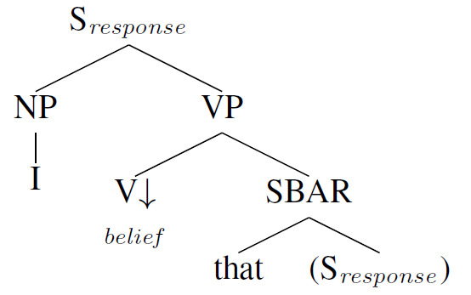
The Generation System
Template-Based Generation
Templates = sub-trees
Leaves = placeholders
other sub-trees
functions generating referring expressions
Generation function
Receives (relevant part of) input;
Emits parts of speech:
Referring expressions
Sentiments
Notes:
Created template based generation in which templates are like trees with place holders that are expanded by either additional sub-trees of by functions that take some of the input (topic, sentiment (from agenda or content element), relations) and generate referring expressions (Noun Phrases) or sentiment expressions (actually a Verb Phrase).

Slide 17
Example
content_element: {
topics: [iPhone,...],
sentiment: -5,
}
_{agenda: {}
_{topic: iPhone,}
_{sentiment: 4}
}
Lexicon
D | A | R
+ | + | +
+ | - | -
- | + | -
- | - | +

Slide 18
content_element: {
topics: [iPhone,..],
sentiment: -5,
}
agenda: {
topic: iPhone,
sentiment: 4
}
Lexicon
D | A | R
+ | + | +
+ | - | -
- | + | -
- | - | +

Slide 19
content_element: {
topics: [iPhone,..],
sentiment: -5,
}
agenda: {
topic: iPhone,
sentiment: 4
}
think
Lexicon
D | A | R
+ | + | +
+ | - | -
- | + | -
- | - | +

Slide 20
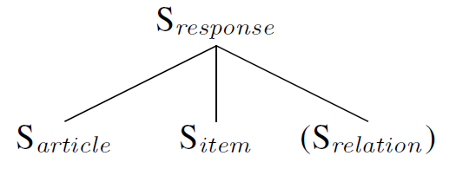
content_element: {
topics: [iPhone,..],
sentiment: -5,
}
agenda: {
topic: iPhone,
sentiment: 4
}
Lexicon
D | A | R
+ | + | +
+ | - | -
- | + | -
- | - | +
think

Slide 21
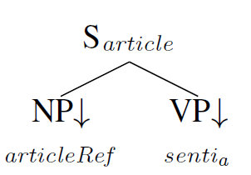
content_element: {
topics: [iPhone,..],
sentiment: -5,
}
agenda: {
topic: iPhone,
sentiment: 4
}
The article
is wrong
Lexicon
D | A | R
+ | + | +
+ | - | -
- | + | -
- | - | +
think

Slide 22
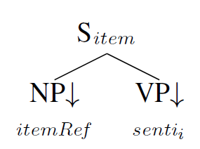
content_element: {
topics: [iPhone,..],
sentiment: -5,
}
agenda: {
topic: iPhone,
sentiment: 4
}
The device
is quite good
Lexicon
D | A | R
+ | + | +
+ | - | -
- | + | -
- | - | +
think
The article
is wrong

Slide 23
content_element: {
topics: [iPhone,..],
sentiment: -5,
}
agenda: {
topic: iPhone,
sentiment: 4
}
Lexicon
D | A | R
+ | + | +
+ | - | -
- | + | -
- | - | +
think
The article
is wrong
The Device
is quite good

Slide 24
The Generation Systems
Notes:
The baseline takes the content element from analysis stage and agenda and generates a response.

Slide 25
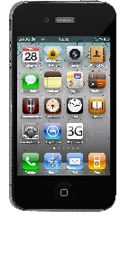
Knowledge-Based Generation
Introduce world knowledge to expand the generation
CompetesWith
Creates
CreatedBy
CompetesWith
CompetesWith
Notes:
KB can be used to expand the response

Slide 26
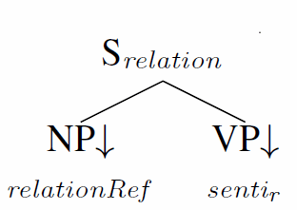
content_element: {
topics: [iPhone,..],
sentiment: -5,
}
CompetesWith
Creates/
CreatedBy
CompetesWith
agenda: {
topic: iPhone,
sentiment: 4
}
Apple
is cool
Lexicon
D | A | R
+ | + | +
+ | - | -
- | + | -
- | - | +
think
The article
is wrong
The Device
is quite good
Apple
is cool

Slide 27
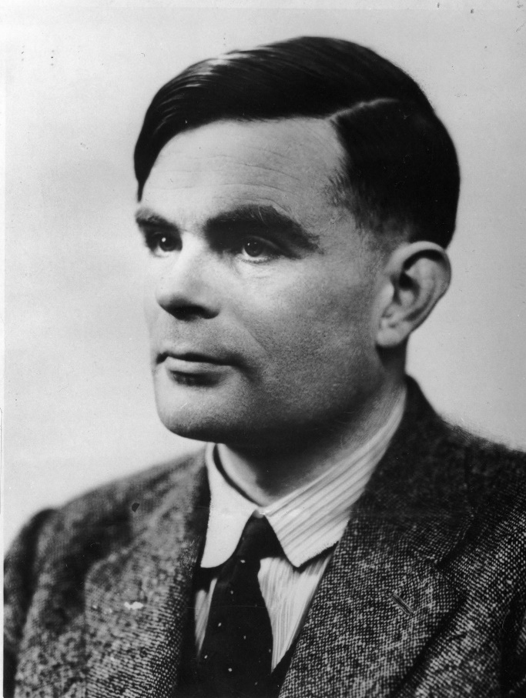
How (and what) to evaluate?
Mapping into ∑*
No way to define “gold standard”
Should be human-like
Need to consider also relevance
Turing to the rescue!
Evaluate using human evaluators
Measure whether response seems human
Also evaluate if the response is relevant
Notes:
We are trying to generate sentences that could be anything. There is no “correct” response and it is affected by many factors – so there is no way to define a gold standard.
The response should be human like (and relevant – we are trying to convince, express opinion within context). because this is our target= real interaction online. Thus, follow the Turing Test idea – evaluate using human – measure how humans evaluate the human-ness of the response and whether it is relevant to the document.

Slide 28
Evaluation Setup
Humans evaluate different aspects of generated responses:
Using Mechanical Turk surveys
Two Surveys, evaluating:
Human-likeness
Response Relevance
Survey Materials:
Documents related to mobile device.
Processed ~300 online documents resulting in 10 trained topics.
Generate responses for diverse sentiment levels for 10 documents.
Collected 5-10 real, human responses for the same documents.
Notes:
Describe our evaluation settings.

Slide 29
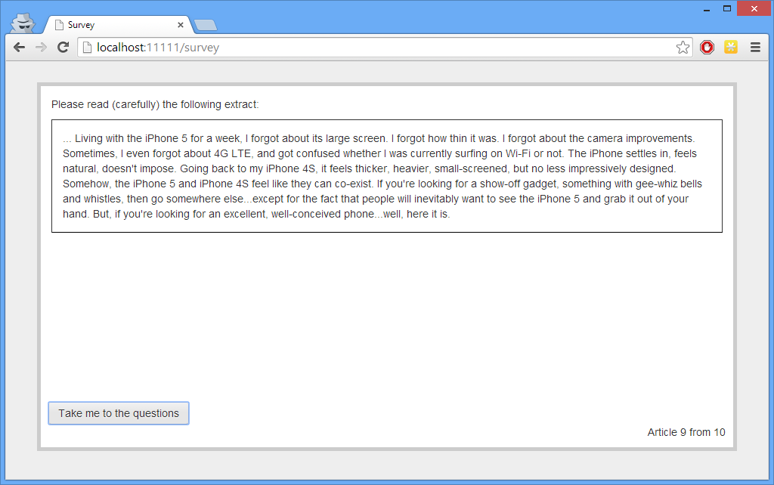
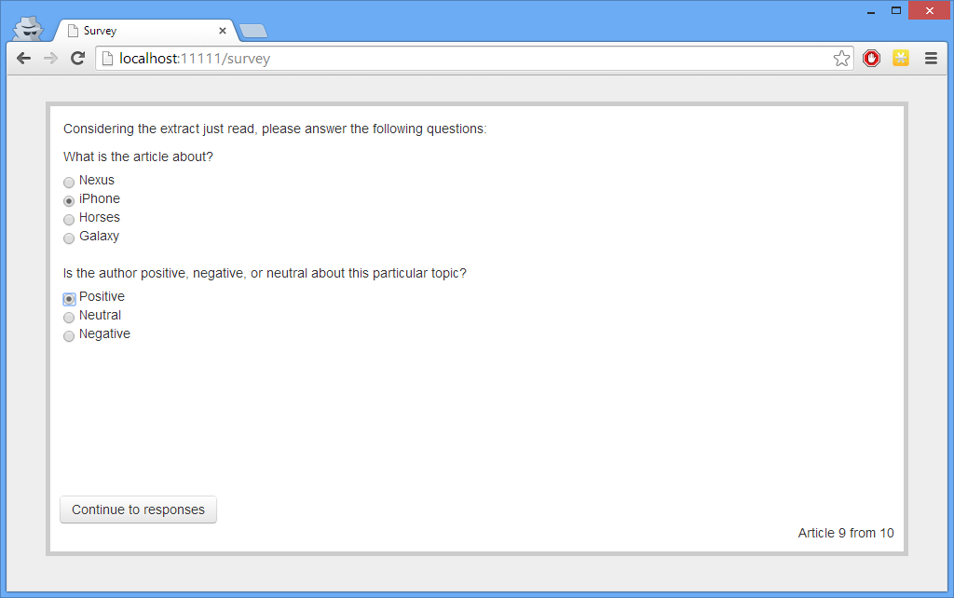
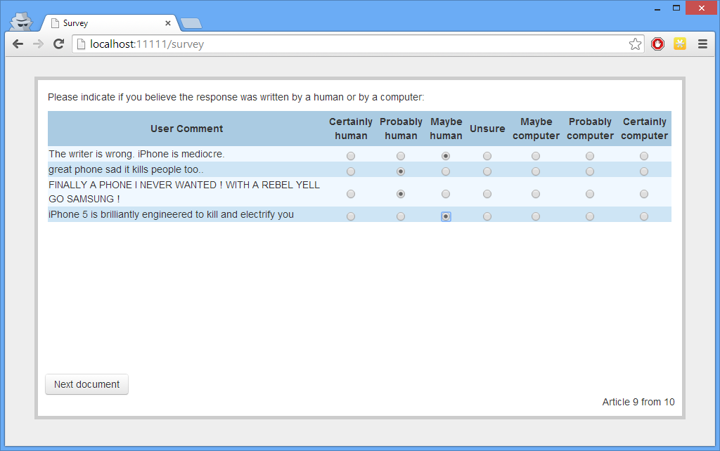
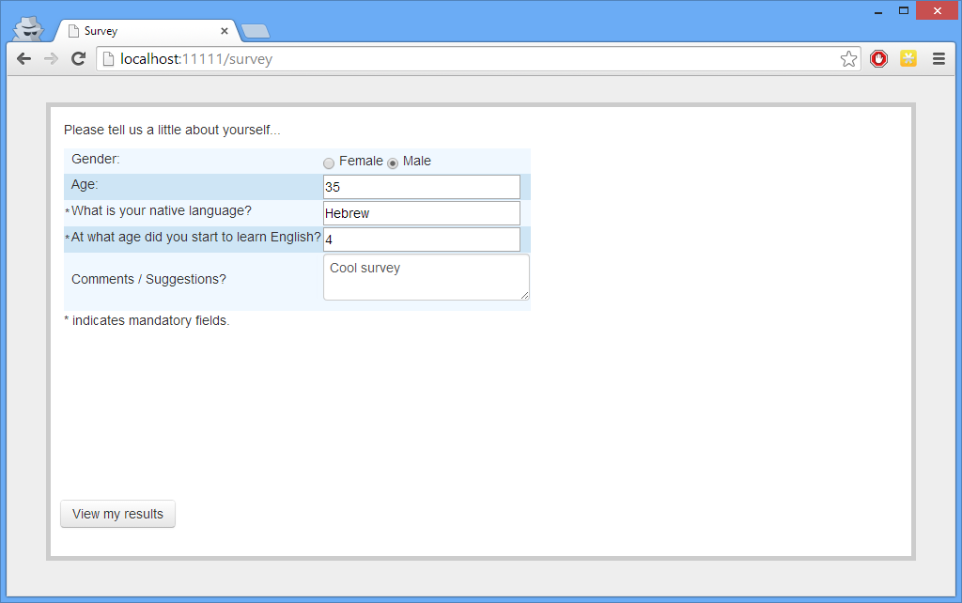
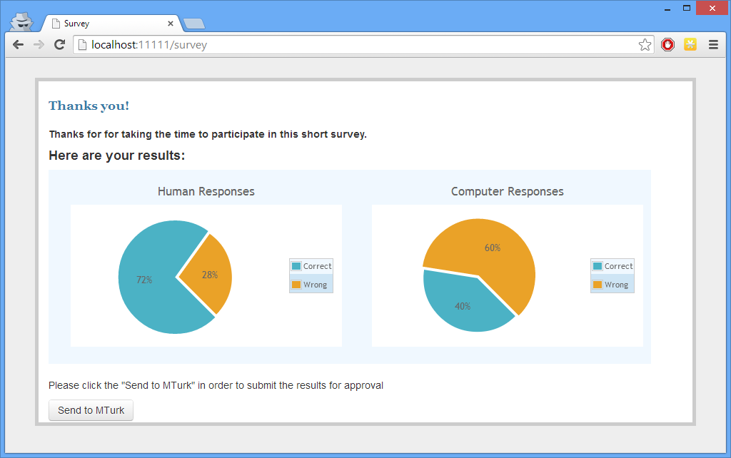
Notes:
Describe the actual survey.
Should we show screenshot(s) of the survey?

Slide 30
Survey 1: Human-Likeness
Human- or Computer-generated response?
akin to (a simplified version of) the Turing test
4 responses per document
3 human
1 computer, either with or without KB
7-point scale – from 1 (Certainly human) to 7 (Certainly computer)
Notes:
Describe the first survey

Slide 31
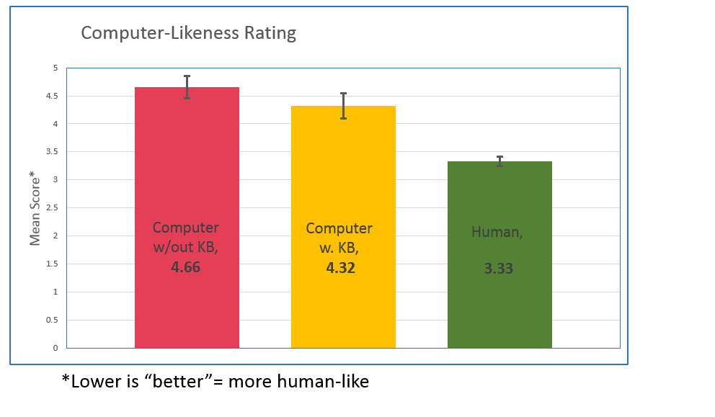
Survey 1: Human-Likeness
*Lower is “better”= more human-like

Slide 32
Survey 1: Human-Likeness
Factors Affecting Human Likeness
Factor | b | P(b<0)
(intercept) | 4.022
KB | -0.240 | 0.987
POS | 0.144 | 0.000
SENT | 0.035 | 0.002
abs(SENT) | -0.041 | 0.967
KB x POS | 0.023 | 0.121
Regression Analysis Predictors:
KB = with/without KB.
POS = position of the trial in the survey.
SENT = Sentiment level

Slide 33
Survey 1: Learning Effect
Factor | b | P(b<0)
(intercept) | 3.590
POS | 0.069 | 0.000
IS_COMP x POS | 0.085 | 0.000
IS_COMP | 0.193 | 0.015
Regression Analysis Predictors:
POS = position of the trial in the survey.
IS_COMP = response generated by computer

Slide 34
Survey 1: Analysis/Insights
World Knowledge increases human-likeness
Sentiment has an effect:
Positive Sentiment perceived as more computer like
Extreme sentiment (+/-) perceived as more human-like
We observed a learning effect
Humans learn to differentiate in the course of the survey

Slide 35
Survey 2: Relevance
Computer responses were clearly judged as relevant
Clearly, including topic makes response relevant
Random responses were clearly judged as less relevant
Human Response were still more relevant
Even without explicitly referring to the topic
How come?
What makes human responses more relevant?

Slide 36
Future Work
Increase KB with modified traversal techniques
Use existing large-scale resources (e.g. Freebase)
Grammar-based generation
“Hand crafted” or following empirical study of actual responses
Theoretical study of online responses
common linguistic characteristics (length, structures, mannerism)
Empirically evaluate these characteristics
Can lead to better understanding of the process
Interdisciplinary collaboration
Notes:
Briefly discuss future work.

Slide 37
Conclusions
Hard task – human-like response takes processing, innovation, resources.
What make responses human-like and relevant?
“Turing”: 4.32 (computer) vs. 3.33 (human) – still have to improve.
Relevance: not far off (4.52 vs. 4.85)
KB/World knowledge is important!
Many ideas for improving the system:
Decrease Learning Effect by increasing variations
Increase variation using a larger knowledge-base, better templates, improved analysis and better lexicon
Improving templates and lexicon via theoretical and empirical studies
An interdisciplinary quest for AI: many research paths to follow…

Slide 38
Thanks!
Check source code and data at: http://www.tsarfaty.com/nlg-sd/
Also, we’d love to hear your ideas and thoughts!

Slide 40
Architecture (see article)
1
3
2
1. Gensim Topic Models: Rehurek and Sojka, 2010
2. WSD Sentiment Scorer: Kathuria, 2012
3. SimpleNLG Surface Realizer: Gatt and Reiter, 2009
Notes:
Topic learning offline using relevant corpus. Can be supervised or not.
Define agenda based on topics
For a new document – topic inference and sentiment scoring before passing results to generation components
The idea is that components could be swapped.
More details and exact components in the published paper.

Slide 41
Survey 2: Relevance
Is the response relevant to the document?
Rate the response relevance
5 responses per document
3 human
2 computer, either with or without KB
1 of each (human/computer) from (random) different article.
7-point scale – 1 (Completely not relevant) to 7 (Completely Relevant).
Notes:
Describe the second survey

Slide 42
Survey 2: Relevance
Responses from other document noticeably less relevant
More so for computer generated (explicitly addresses topic)
Computer response almost as relevant as human (mean 4.52 vs. 4.85)
Including the topic was important
No effect of KB on relevance
Extra “knowledge” does not contribute (already relevant by including topic)
Notes:
Describe the second survey

Slide 43
Survey 2: Human vs. Computer
Response Type |  | Mean* and CI
Human | this
 | other
Computer (all) | this
 | other
Computer (-KB) | this
 | other
Computer (+KB) | this
 | other
Factor | b | P(b<0)
(intercept) | 3.590
IS_COMP | -0.339 | 1.000
POS | 0.824 | 0.000
IS_COMP x POS | 0.176 | 0.000
*Higher is “better”
Notes:
Responses are relevant to the snippet they are created for (so including the topic and sentiment is important)
Human responses more relevant (why). Confirmed by negative coefficient of IS_COMP

Slide 44
Survey 2: with and without KB
Response Type |  | Mean* and CI
Computer (-KB) | this
 | other
Computer (+KB) | this
 | other
Factor | b | P(b<0)
(intercept) | 3.603
KB | 0.026 | 0.322
SOURCE | 1.003 | 0.000
SENT | 0.023 | 0.029
abs(SENT) | -0.017 | 0.819
KB x SOURCE | 0.032 | 0.731
*Higher is “better”
Notes:
KB has no effect on relevance
Source does, more significant for Computer (because of explicit reference to topic)

Slide 45
Architecture: Components
Components used:
Topic Modeling – Gensim – fast implementation of LDA
Rehurek and Sojka, 2010
Sentiment Analysis – WSD based semantic/lexical implementation
Kathuria (2012)
Generation – templates hand coded in Java using SimpleNLG
Gatt and Reiter, 2009
Notes:
Overview of components used, maybe talk that they are just the basic and call for improvements (or leave that to the end)

Slide 46
Our Model – From Analysis to Generation
“I think that …
and product is really…”
Notes:
Talk about the generation “formally”
Move all in all to the end of the example

Slide 47
Related Work - Background
Topic Model – probabilistic generative modeling technique that allows for the discovery of abstract topics over a large body of documents
Papadimitriou et al.,1998; Hofmann, 1999; Blei et al., 2003
We used Latent Dirichlet Allocation (LDA) (Blei et al., 2003; Blei, 2012)
Sentiment – infer the sentiment that is expressed in the text with relation to the topic(s) identified in the document
Ample research in field: sentiment analysis (Davidov et al., 2010), mood aggregation (Agichtein et al., 2008), opinion mining (Mishne, 2006)
We used Word Sense Disambiguation (WSD, Baccianella et al., 2010) for getting a score for the whole document (A simplification)
Notes:
Here, describe/mention related work and state which libraries one we used

Slide 48
Related Work - Background
Generation – template based approaches
E.g. Reiter and Dale (1997) and Van Deemter et al. (2005)
Templates are essentially sub-trees with leaves that are placeholders for other templates or for functions generating referring expressions (Theune et al., 2001)
Notes:
Explain the generation

Slide 49
Related Work – Toward evaluation
Not much research in the field – generating responses (in online context).
Similar to Chat bots but still too different
Research attempts for natural human-like interaction (Mori et al., 2003; Feng et al., 2006).
However, typically designed to provide an automated one-size-fits-all type of interaction (“scripts”)
Related to Persuasion (Fogg, 1998; Fogg, 2002)
Complementing research (similar goals) but different settings.
Pursue in future research.
Notes:
Here, I want to discuss actual related work. To be honest, I initially set the overall layout but when writing it, I think this is misplaced (or need to change the title)

Slide 50
Related Work – Toward evaluation
Ritter (2011)
Generates responses to tweets
Uses data driven, machine translation approach
Uses surveys evaluation
But
Responses (retweets) are not necessarily grammatical
Thus, evaluates only relevance
Also, reuses data previously observed - while we are trying to generating NEW (opinionated) content.
Hasegawa (2013)
Similar approach to Ritter (2011)
Intend to illicit specific emotion in addressee
But still differ:
settings (dialogues versus online posting)
goal itself (eliciting emotion versus expressing opinion)
Notes:
Talk about Ritter and Hasegawa – closest related works that we’ve found. Same comment as above regarding flow…
Possible “resolution”: mention this at the beginning (a slide saying the field is not really explored, much analysis but no generation etc).

